Slide 1
MACHINE JOB SCHEDULING
Team Members
Kavya Sri
Neha Sulthana
Ramya
Mamatha
Varshitha

Slide 2
CONTENTS
Abstract
Introduction
Objective
Software requirements
Software Resources
UML Design
About Project
Advantages
Future Scope
Conclusion

Slide 3
ABSTRACT
In recent years, the manufacturing industry has developed rapidly with fierce competition.
Manufacturing enterprise are faced with the challenge on time deliver, multiple product choices and quick response to order modification. Reasonable and efficient production scheduling determines whether the enterprise can continue to survive.

Slide 4
INTRODUCTION
Job Scheduling is the process of allocating system resources to many different tasks by an operating system.
The system handles prioritized job queues that are awaiting CPU time and it should determine which job to be taken from which job to be allocated for the job.
This type of scheduling makes sure that all jobs are carried out fairly and on time.

Slide 5
DAY 1 TO 5
01 02
SRS UML DESIGN
Software Requirements Understanding the problem and create code
Specification and class ,sequence and sequence diagram for the same
03_04 05
CODING TESTING
Developing our logic using Test our developed application using various
C++ language sunny and rainy test cases

Slide 6
OBJECTIVE
Maximize overall throughput, that is, process as many jobs as possible in a given amount of time.
Allow users to specify individual job priorities a task for a job with a higher priority should be executed first.

Slide 7
SOFTWARE REQUIREMENTS
Cloud Machine
Linux

Slide 8
SOFTWARE RESOURCES
Cpp
Valgrind
Oops

Slide 9
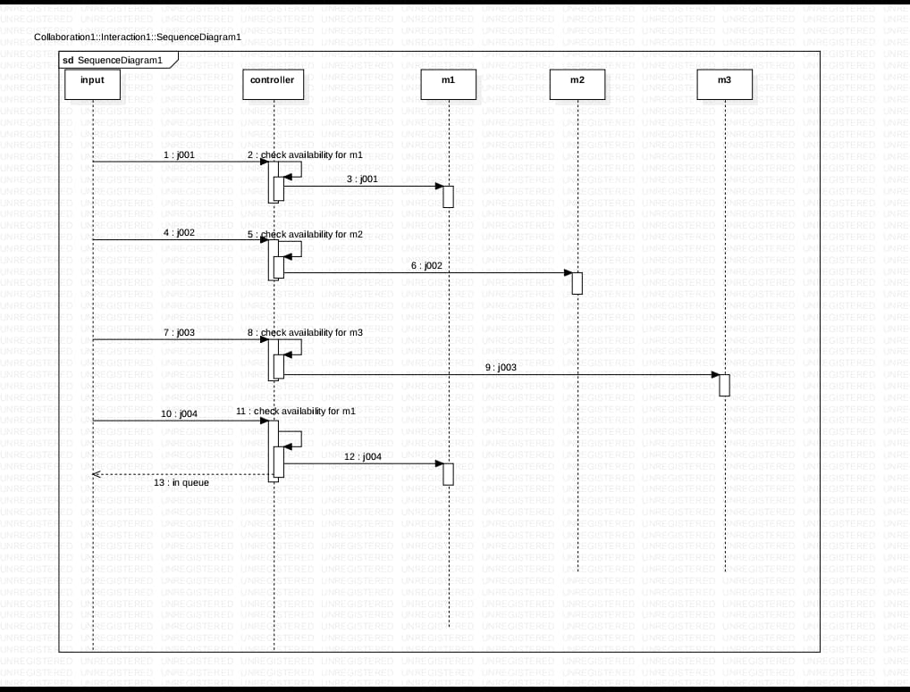
UML Design SEQUENCE DIAGRAM

Slide 10
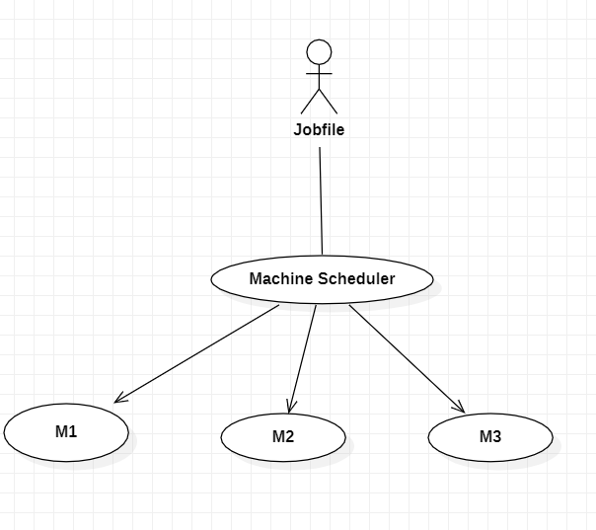
Use Case Diagram

Slide 11
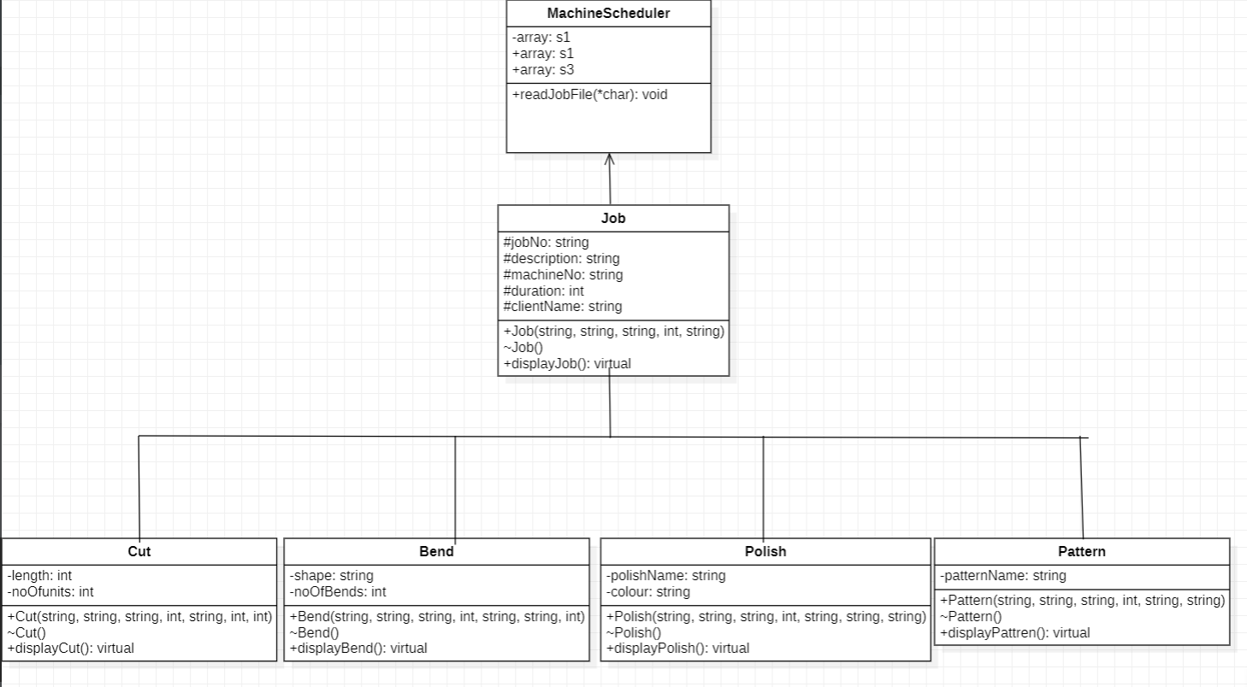
Class Diagram

Slide 12
ABOUT PROJECT
Application has to prepare to schedule for machines.
Information on jobs is available in multiple files, this filenames will be passed to application as command line argument.
Job files has to be taken as parent class and extended data is taken as inheritance.

Slide 13
Each machine to be displayed and stored in schedule1.txt, schedule2.txt & schedule3.txt.
Invalid jobs entries from all input files should be written to invalidJobs.txt file.
Display error messages for invalid entries and those should be discarded.

Slide 14
ADVANTAGES
Allows efficient and timely distribution of information to relevant users.
Ensures that heavy querying is not done during peak hours.
Minimize the manual intervention by automating the processes.
.

Slide 15
Enables users to analyze the changes in the data in real-time.
Makes tracking tasks easier.
Increases productivity.

Slide 16
FUTURE SCOPE
By using multithreading files and input output operations, we can schedule for many machines.
We can use more than one STL to increase flexibility.
We can implement schedule for more than 3 machines, by using maps, vectors, arrays and strings.

Slide 17
CONCLUSION
The fact that constraint programming approaches are so effective is not only relevant for the dedicated purpose, but for industry as well.
In fact, the need for easy adaptability and cheap maintenance in the long run or easily met by such approaches.

Slide 18
THANK YOU

